Slide 1
Benefits of Using Jupyter Notebooks for OCI Python SDK/CLI
Widely Used Tool for Python – particularly in Science and Engineering
Showcases both code and results
Allows Markdown for better documentation including images, videos and LaTex for quality presentations.
Better organization of developed code using TOCs and Sections
Easy to use work from others as a starting point – GitHub Notebooks for OCI
Can run cell by cell to get a better understanding of the code.
Easy to install extensions
Can convert Notebook to pdf and/or slides
Docker Containers capable for Jupyter Labs
GitHub supports Jupyter notebook extensions for easy viewing
Easily parse JSON output from CLI or SDK

Slide 2
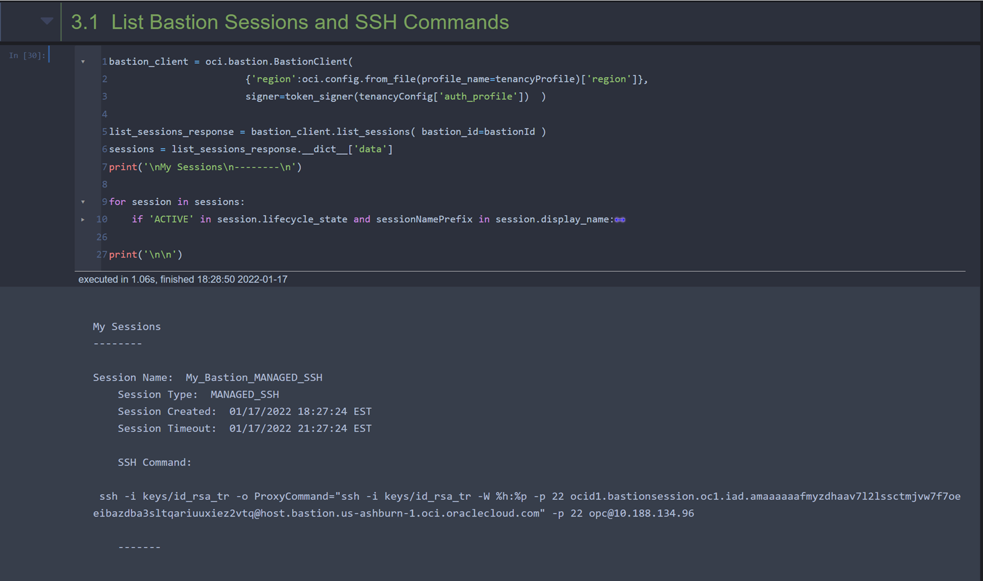
Python Cell Example

Slide 3
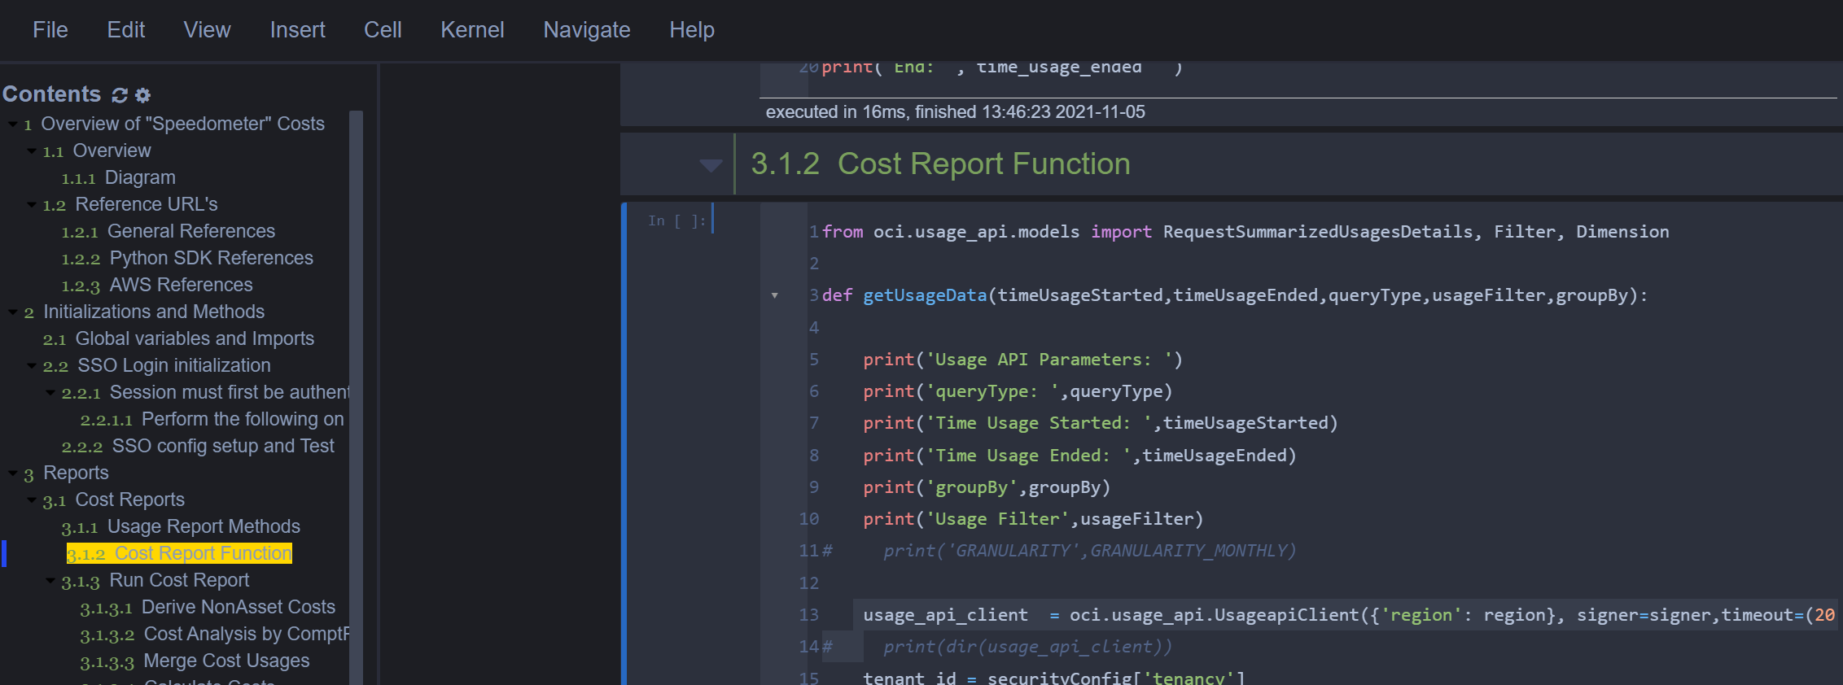
Table of Contents

Slide 4
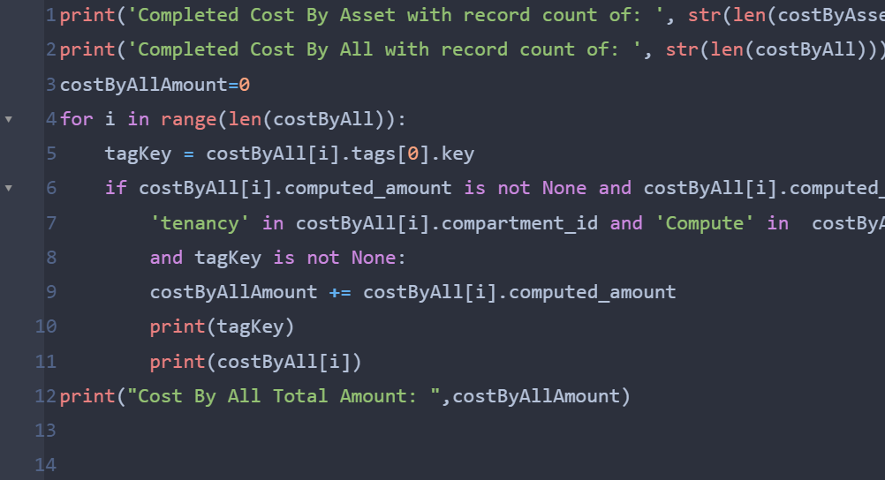
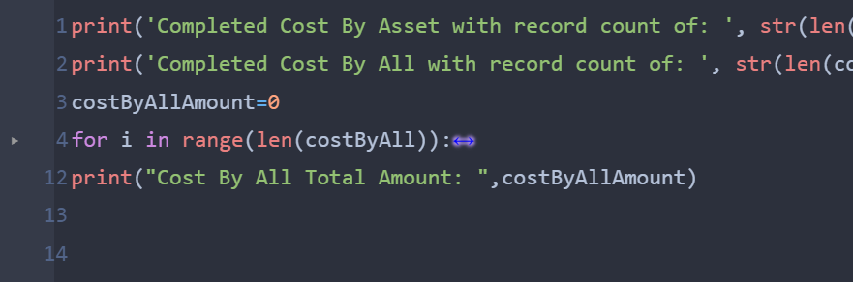
Collapsible Code
Before
After

Slide 5
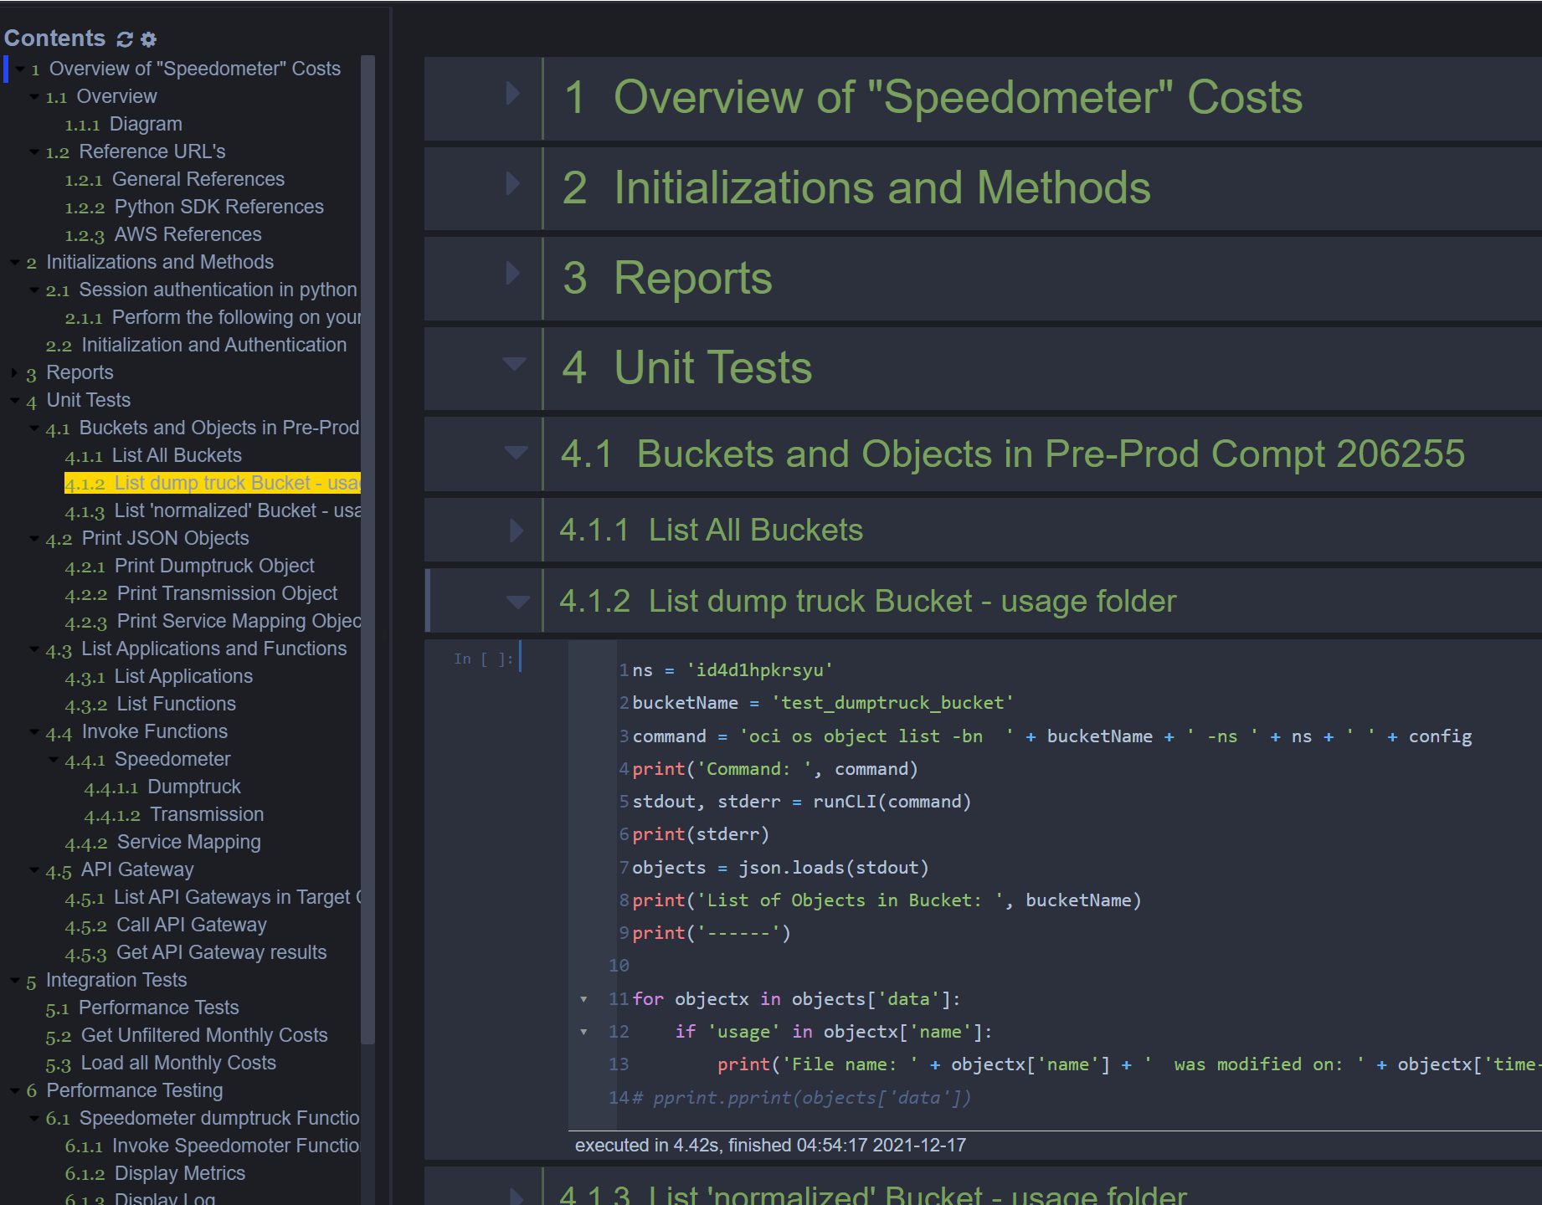
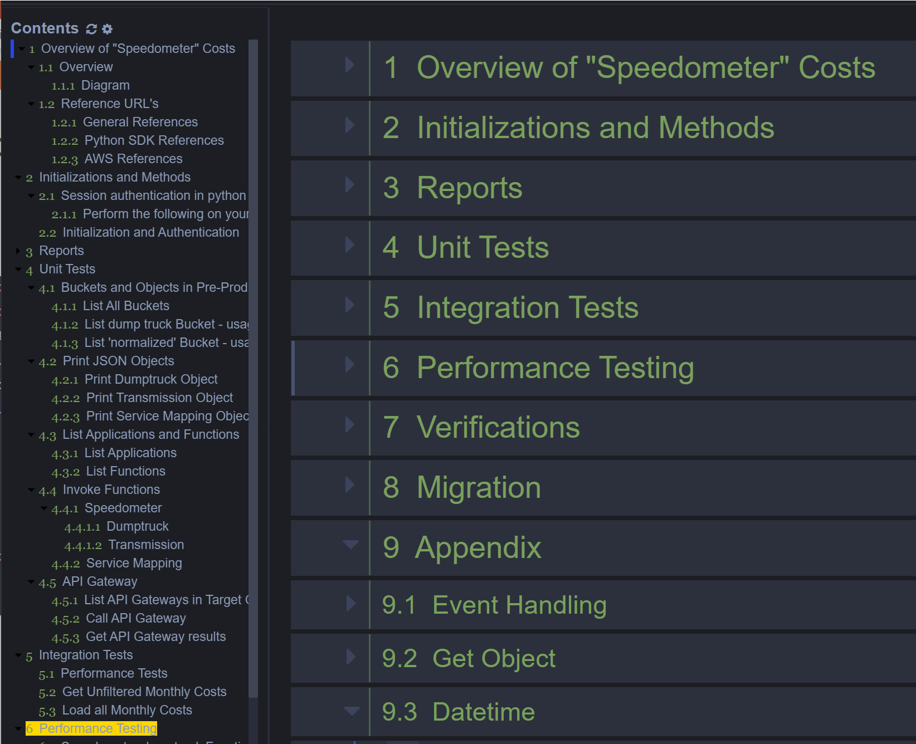
Collapsible Headers
Before
After

Slide 6
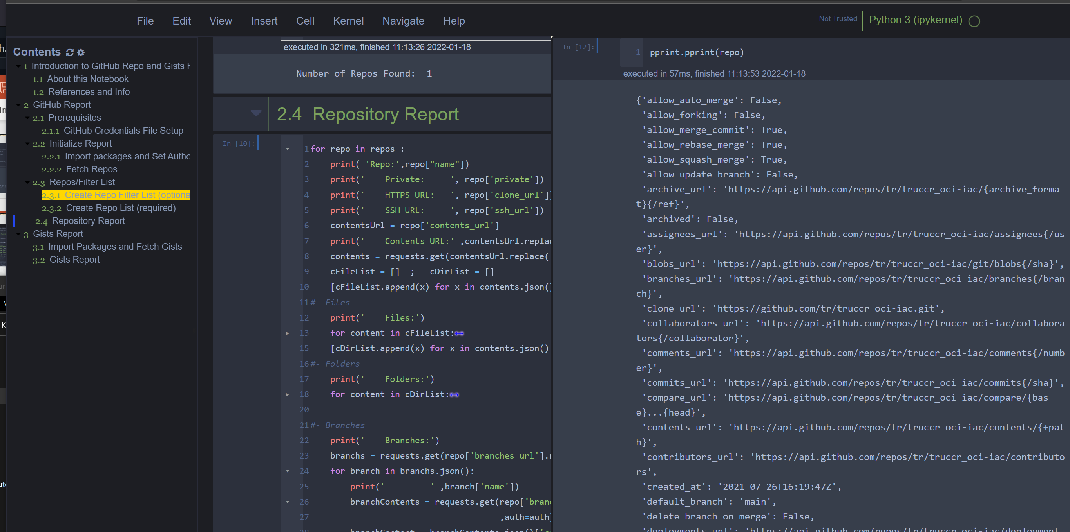
Scratch Pad

Slide 7
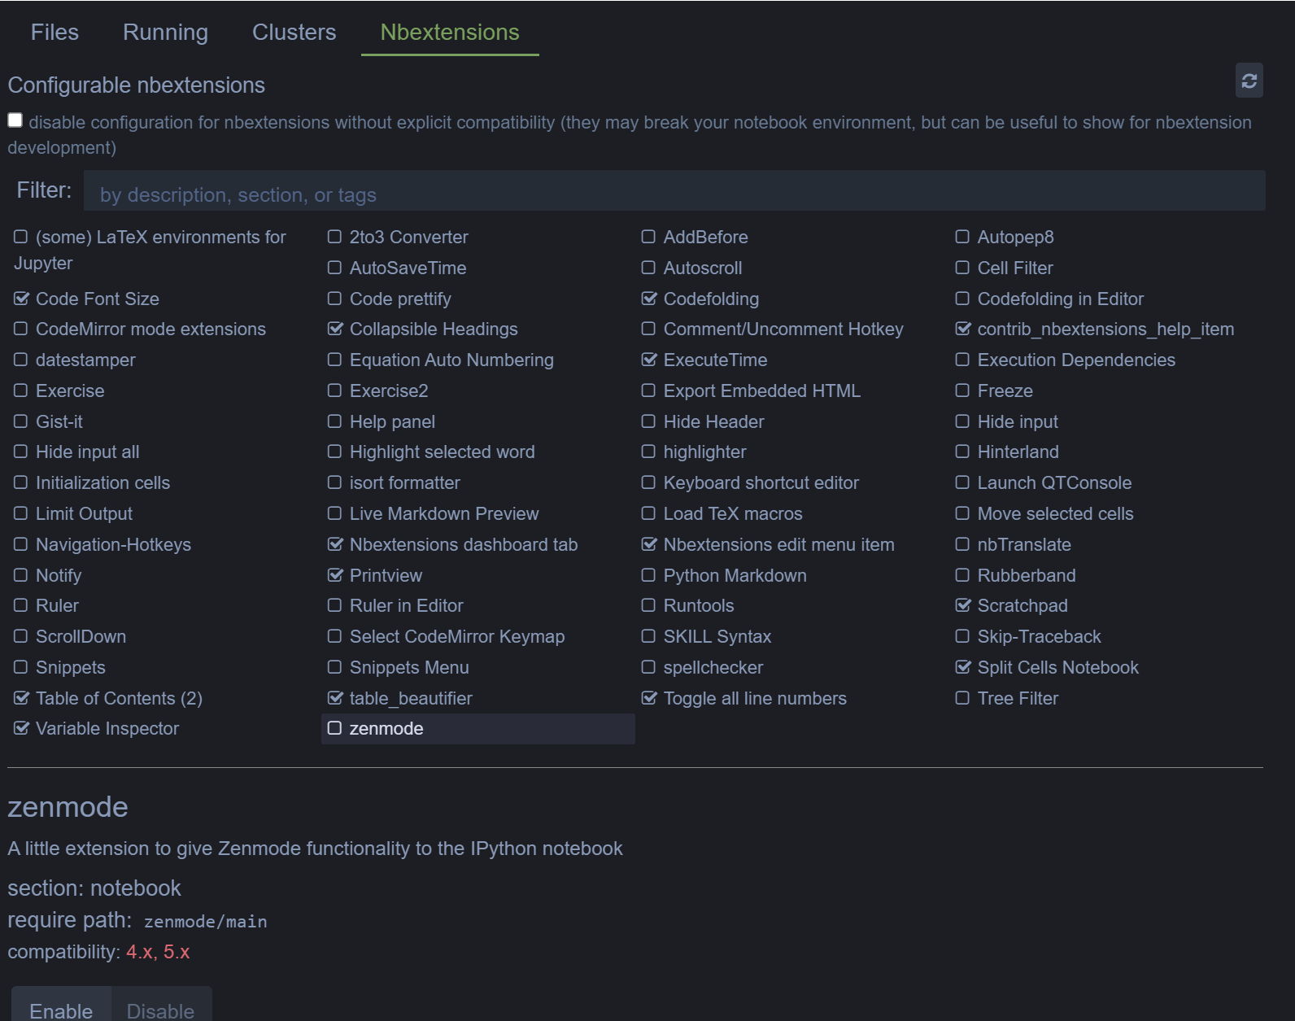
Other Jupyter Extensions

Slide 8
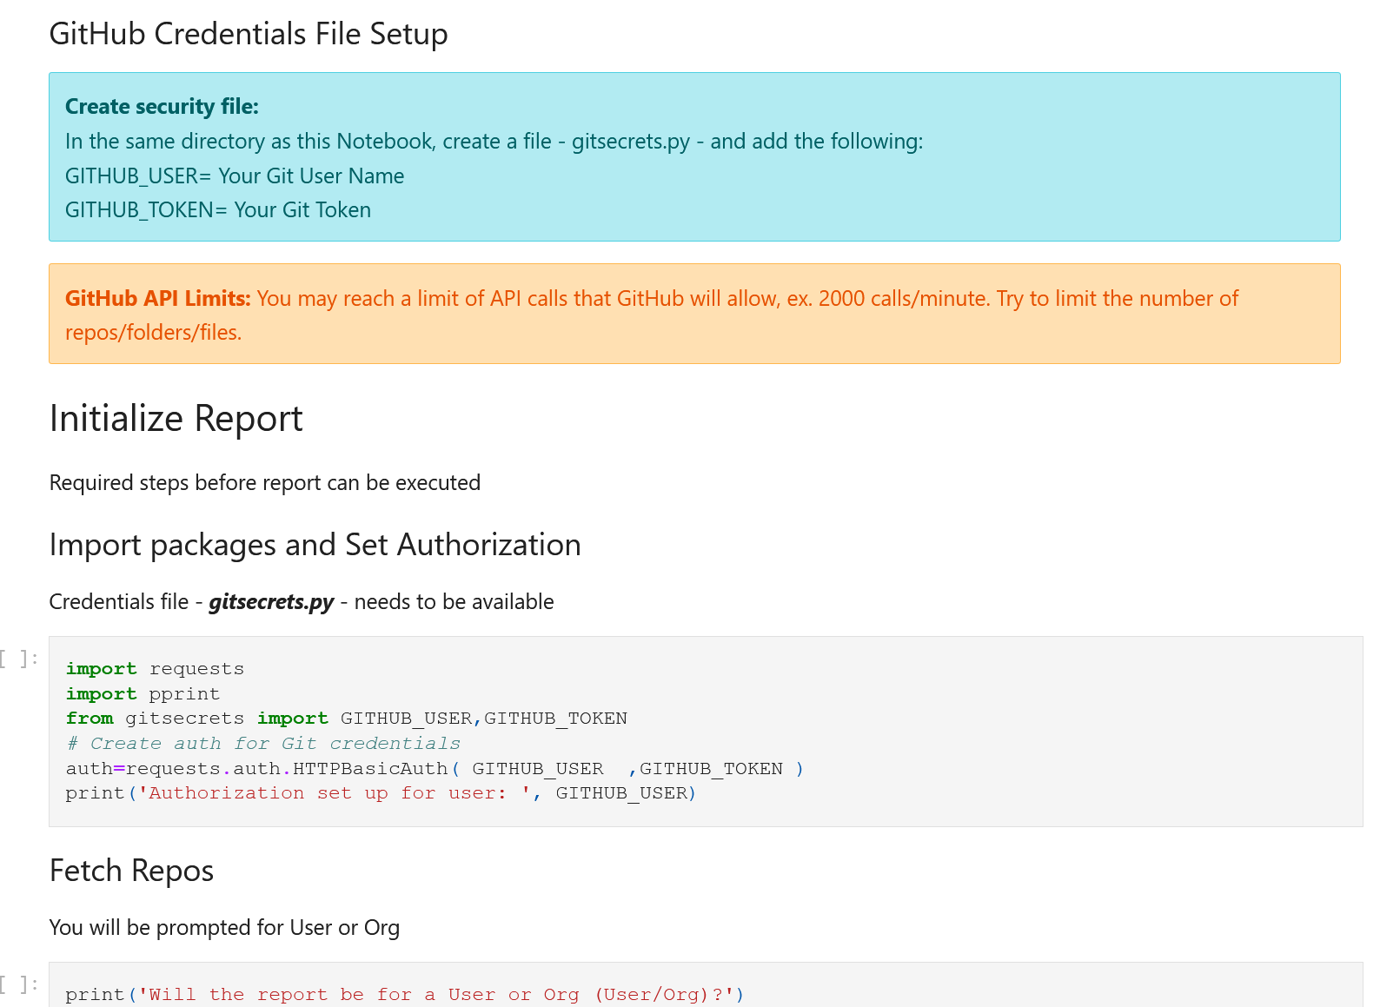
Markdown Example

Slide 9
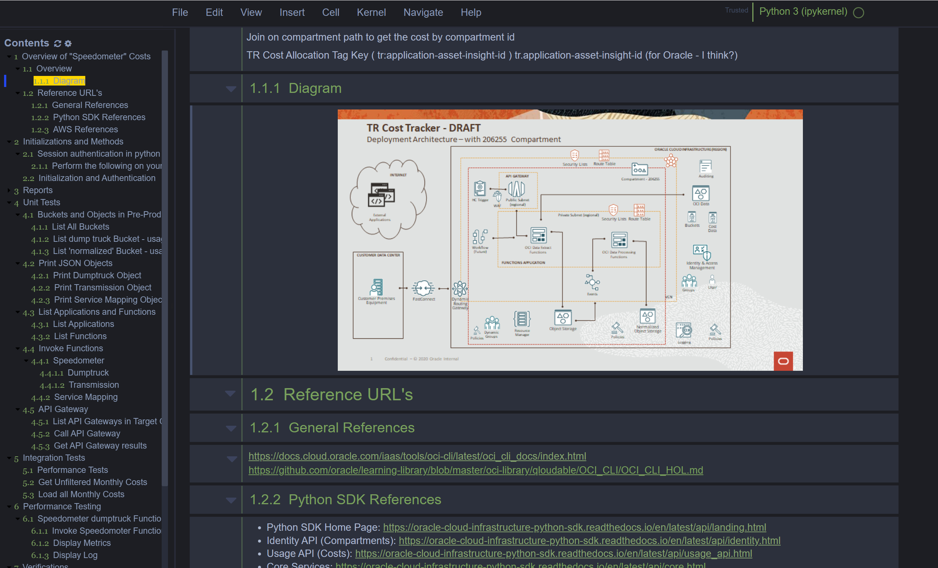
Quality Reporting Examples

Slide 10
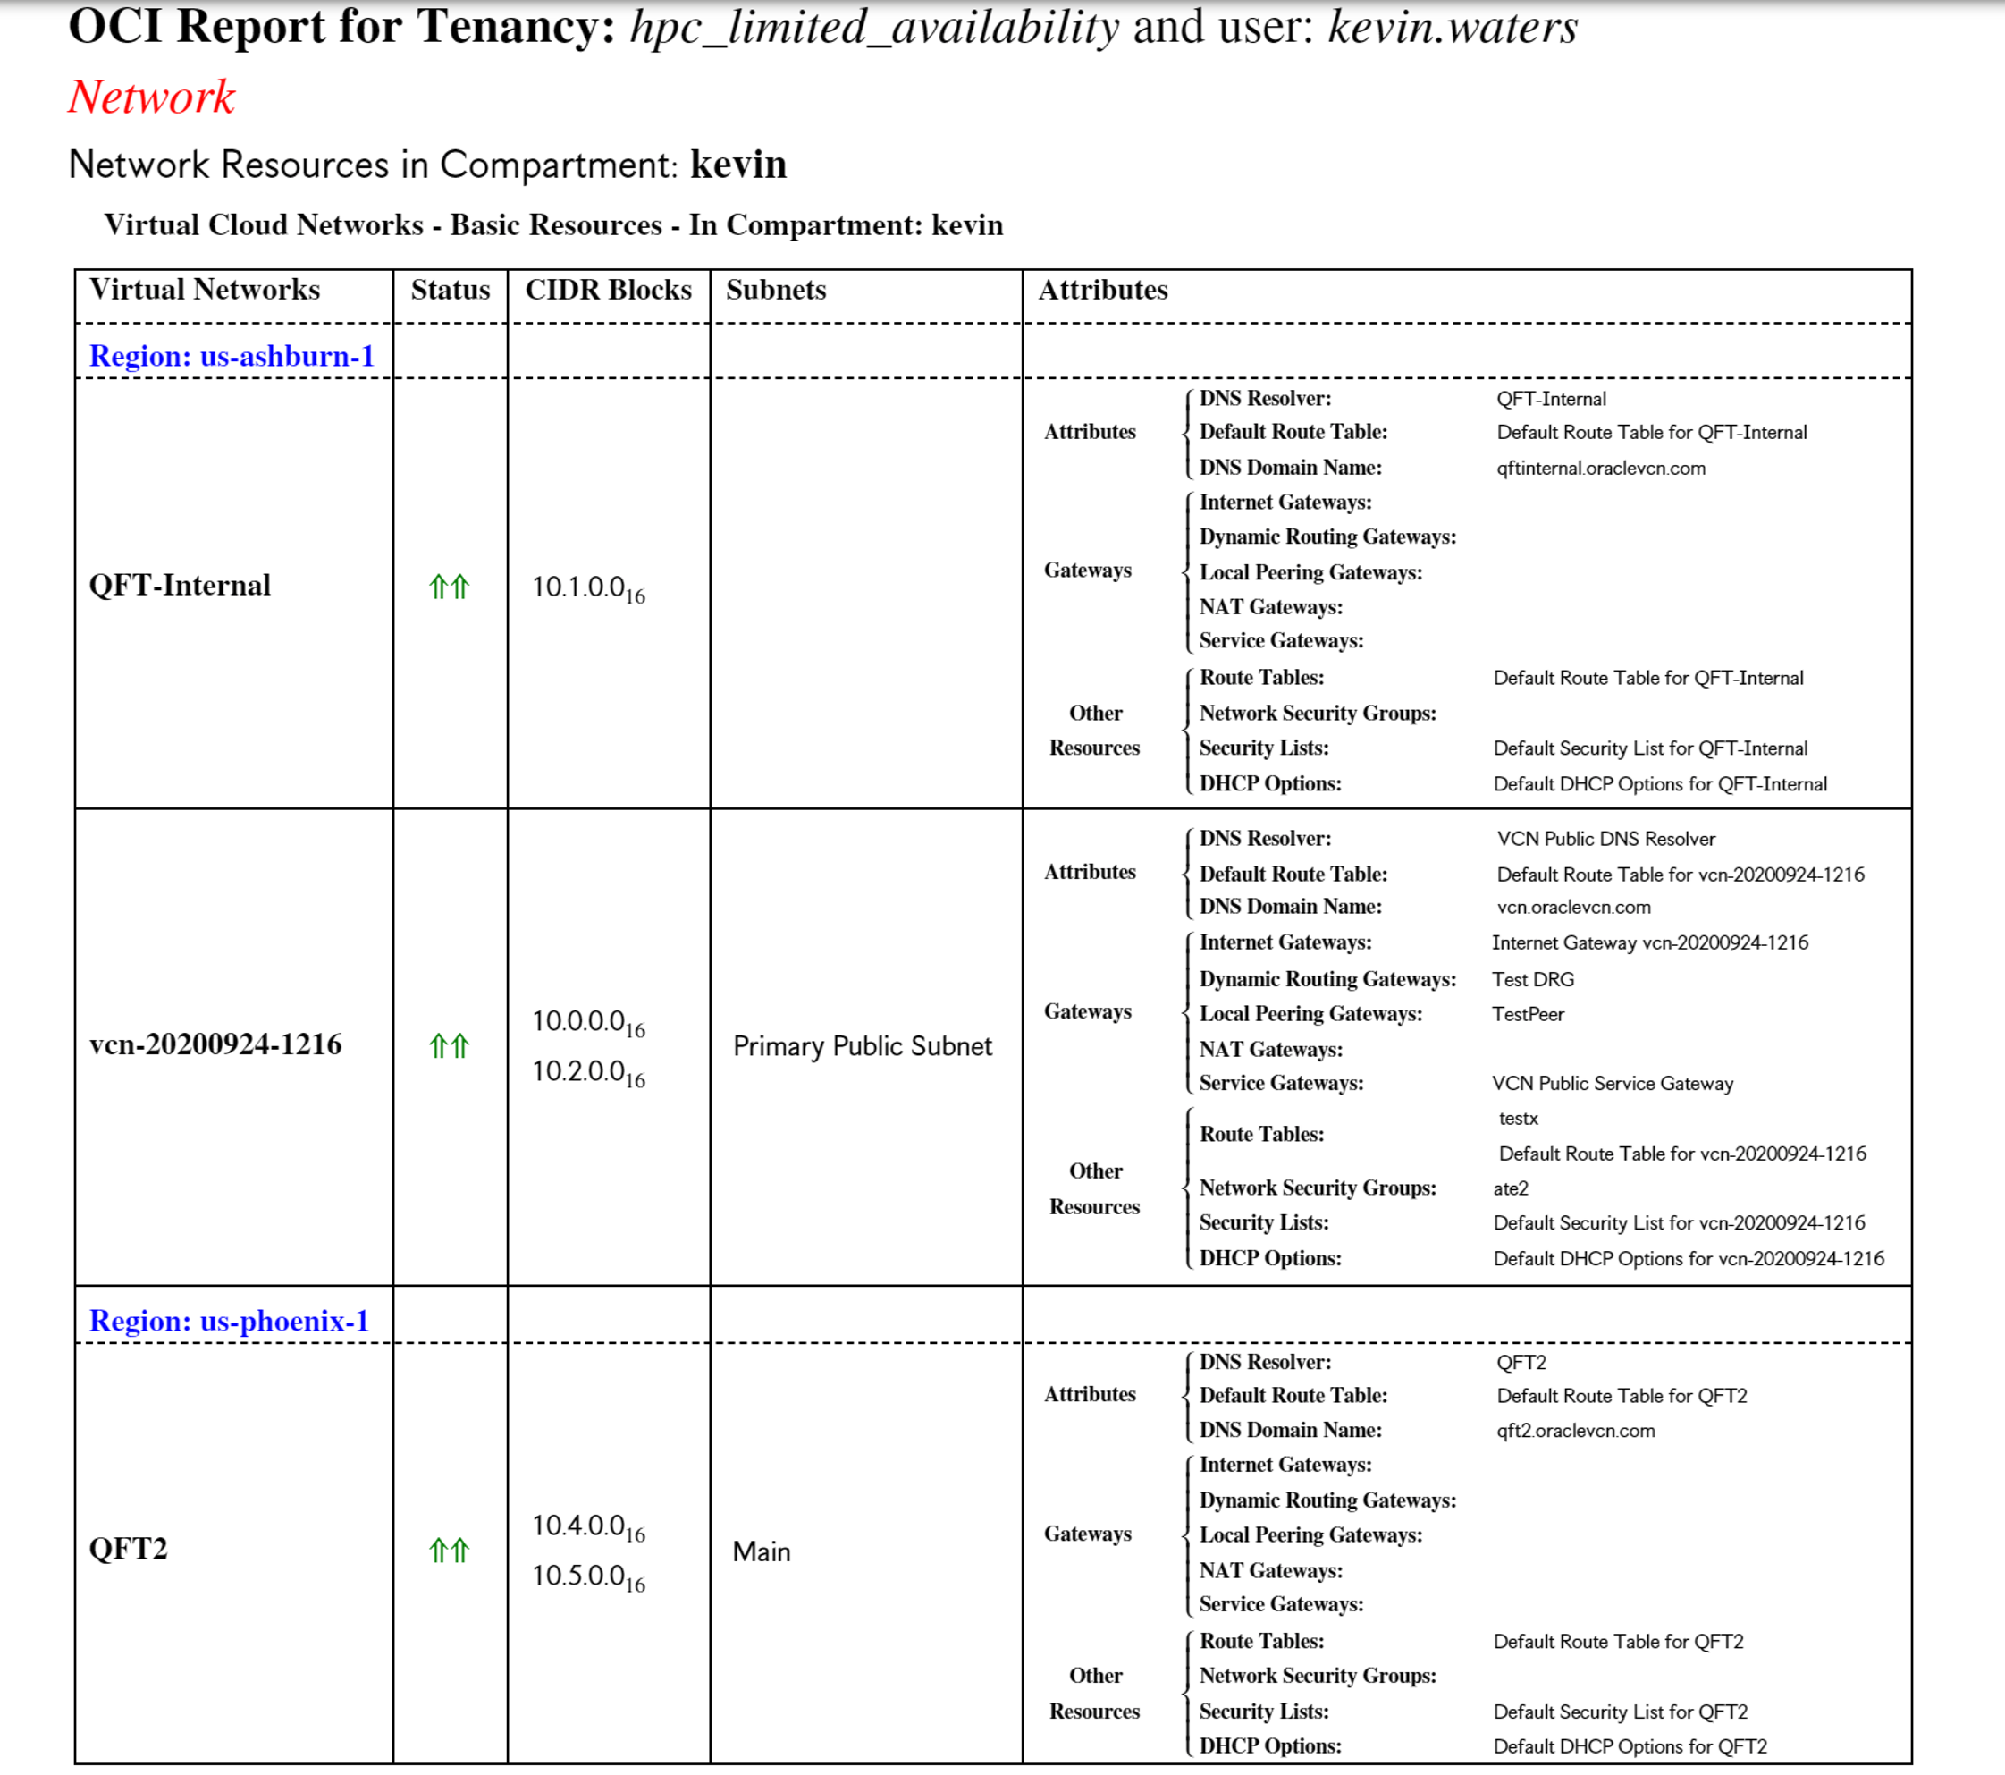
Quality Reporting Examples

Slide 11
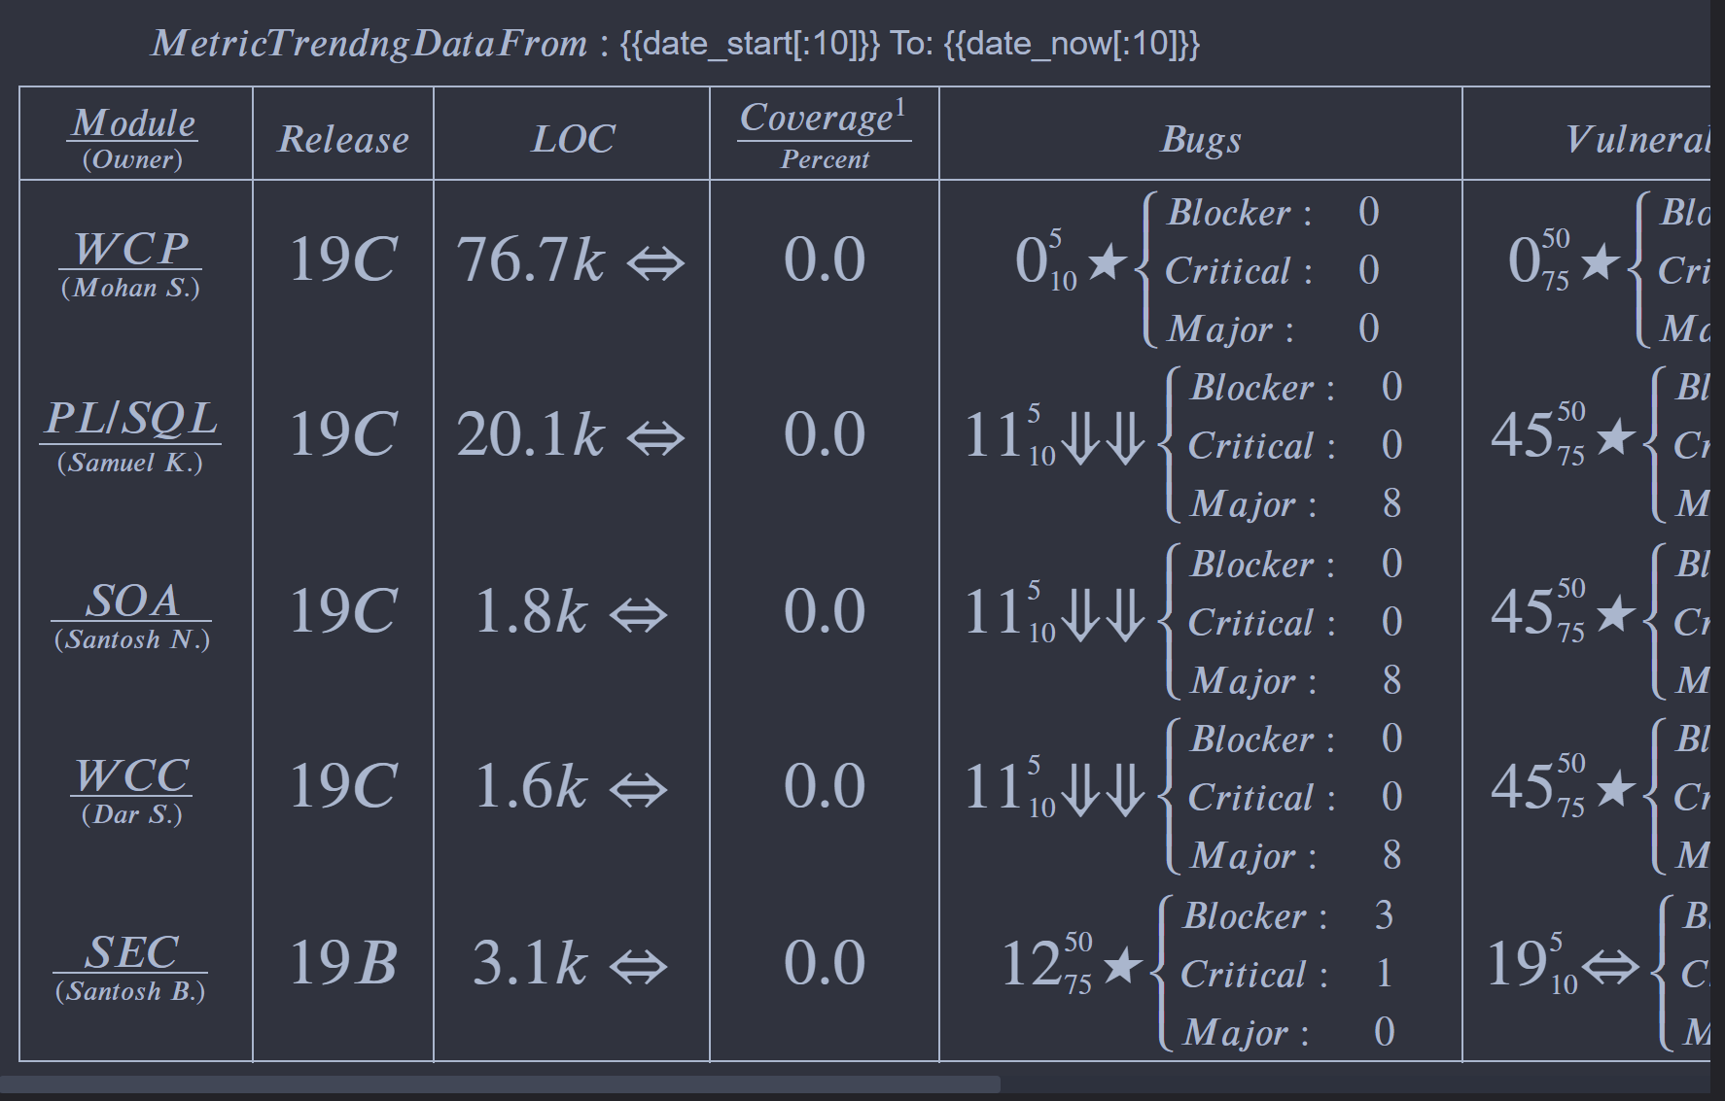
Quality Reporting Examples

Slide 12
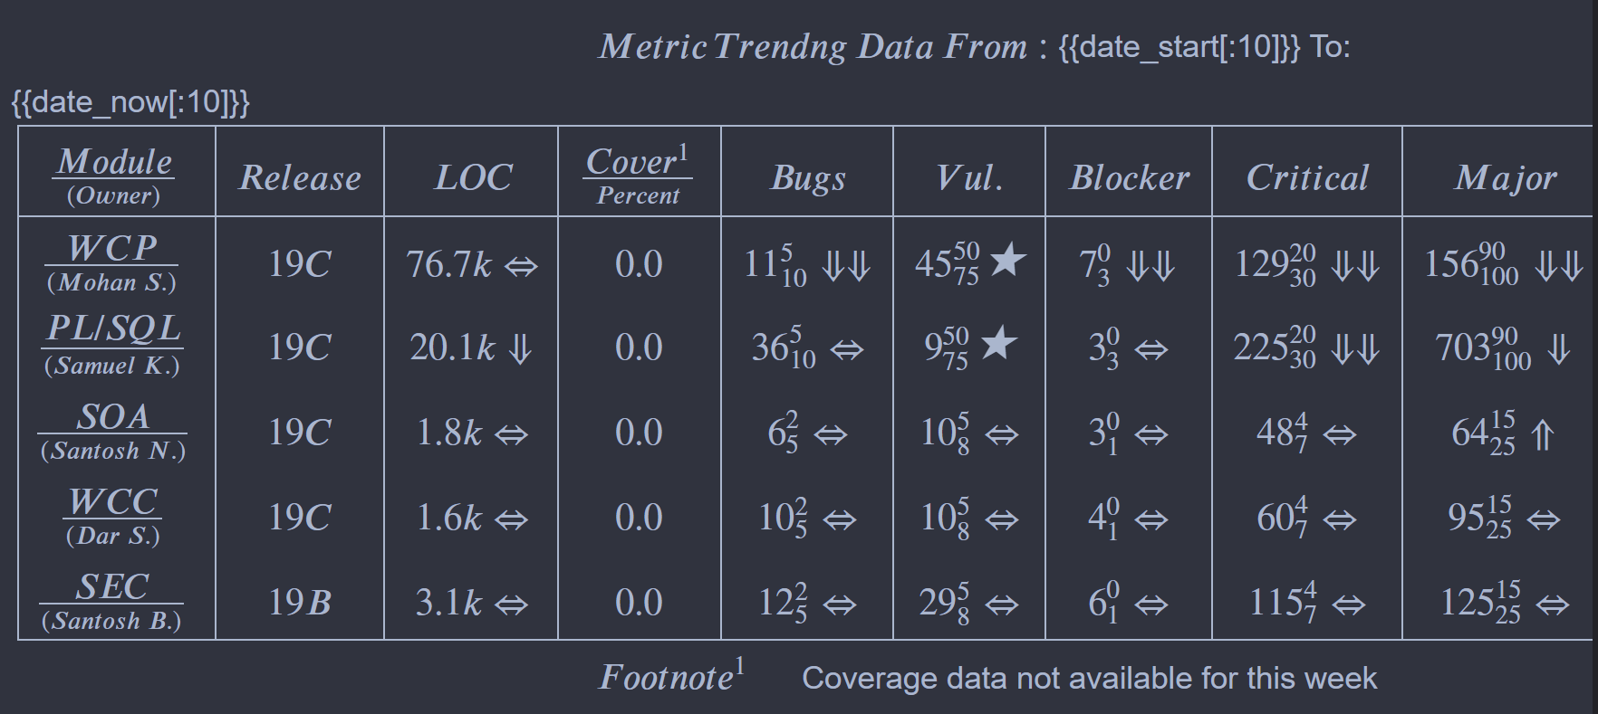
Quality Reporting Examples

Slide 13
Using Jupyter with Native Cloud Python SDK and CLI
CLI – assemble and run CLI using Python
Code assistants and color themes
Reference Links to Notebook
Architecture Diagrams
Useful Python Libraries
Magic Commands
Easy to use
Create PDF report from Notebook
Create Slide Deck from Notebook
nbViewer.org for viewing Notebooks

Slide 14
Terraform Demo

Slide 15
JupyterCloud Repo on GitHub
https://github.com/waters262/JupyterCloud.git
Authentication
Terraform Ops
Bastion Ops
Monitoring Ops
https://gist.github.com/waters262
GitHub Reports

Slide 16
Call for Contibuters
https://github.com/waters262/JupyterCloud
Contributions are what make the open source community such an amazing place to learn, inspire, and create. Any contributions you make are **greatly appreciated**.
If you have a suggestion that would make this better, please fork the repo and create a pull request. You can also simply open an issue with the tag "enhancement".
Don't forget to give the project a star! Thanks again!
1. Fork the Project
2. Create your Feature Branch (`git checkout -b feature/AmazingFeature`)
3. Commit your Changes (`git commit -m 'Add some AmazingFeature’`)
4. Push to the Branch (`git push origin feature/AmazingFeature`)
5. Open a Pull Request

